Slide 1


JAVA
Java is a general-purpose computer programming language that is concurret ,class-base object-oriented. It is intended let application
developers(WORA)
Developer :Sun Microsystems (now owned by Oracle)
First appeared:MAY,23 1995. 22year
Designed by:James Gosling

Slide 2

Learning Modules
Core JAVA(JSE)
INTRODUCTION OF JAVA
JVM
JRE
OBJECT ORIENTED PROGRAMMING IN JAVA
GUI PROGRAMMING
AWT
SWING
JAVA DATA BASE Connectiveity(JDBC)
MULTITHREADING
INPUT/OUTPUT(IO)
NETWORKING
TCP
SOCKET
INTERNATIONALIZATION(I18N)

Slide 3
Learning Modules(Cont’)
Advanced JAVA(J2E)
INTRODUCTION OF JEE ARCHITECTURE
STATIC
DYNAMIC
JAVA SERVLETS
SERVLETS API
SERVLETS LIFECYCLE
JAVA SERVER PAGE(JSP)
REMOTE METHOD INVOCATION(RMI)
JAVA MAIL
UTILITIES
ECLIPS
NETBEANSE
WEB SERVER
TOMCAT SERVER
APPLICATION SERVER
GLASSFISH SERVER

Slide 4
PEOPLE TALK
ABOUT THE PROJECT
My project is WEB Application named as People Talk.
The main aim of this project to communication between two people by searching people by area(location) not name .this web page premium quality, responsive using bootstrap technology
The application contains two modules:
Registration and loging.
2. Find people by specifying the area and talk.
Notes:
This is another option for an Overview slide.

Slide 5
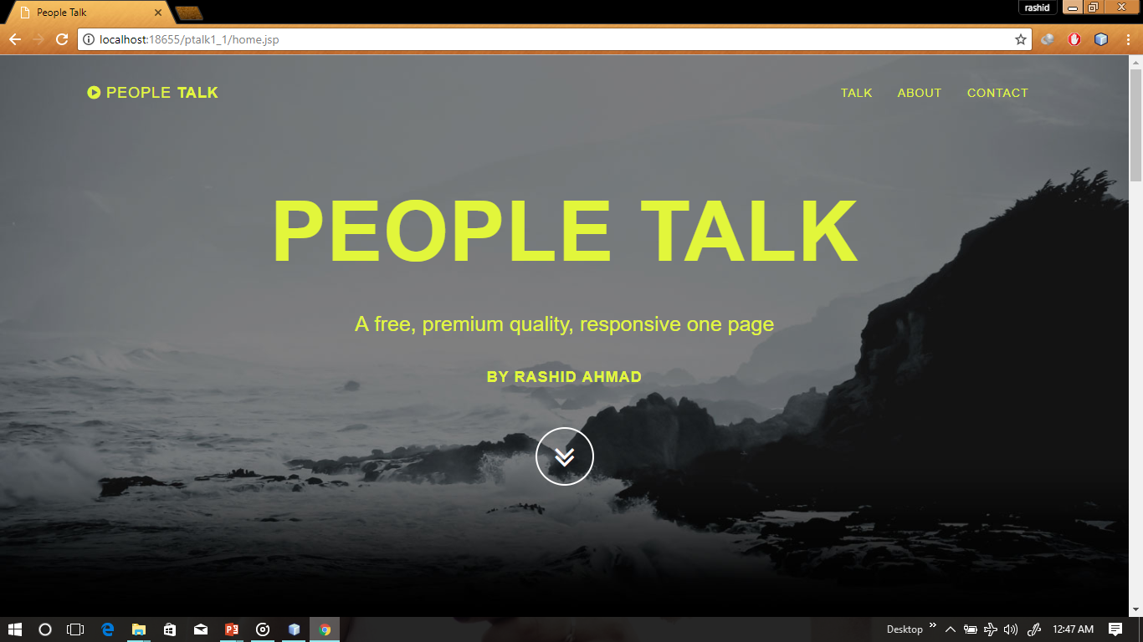
Home Page (starting section)
Notes:
What will the audience be able to do after this training is complete? Briefly describe each objective how the audience will benefit from this presentation.

Slide 6
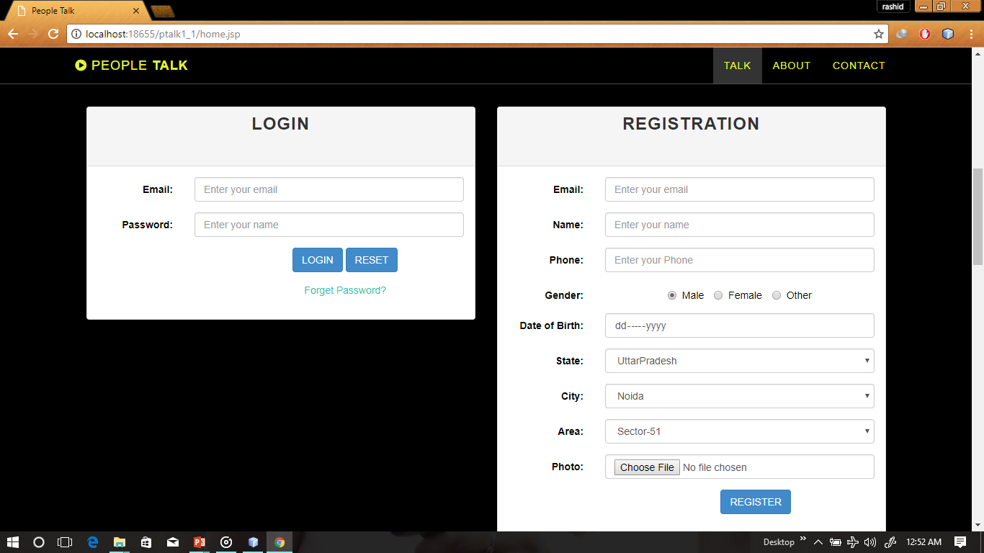
Home Page (Loging section)
Notes:
What will the audience be able to do after this training is complete? Briefly describe each objective how the audience will benefit from this presentation.

Slide 7
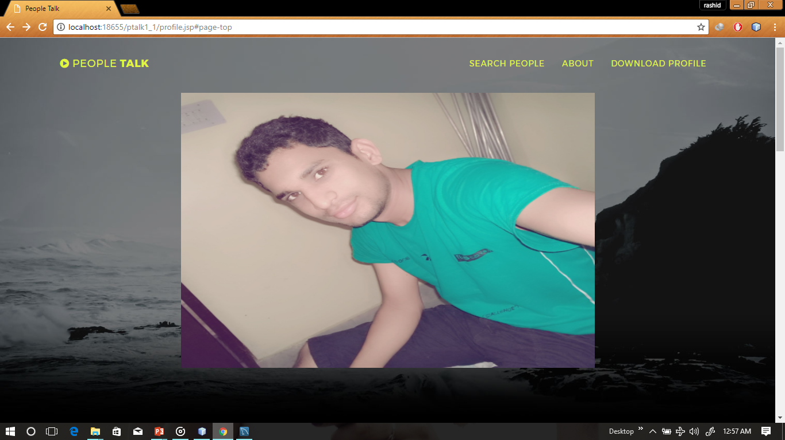
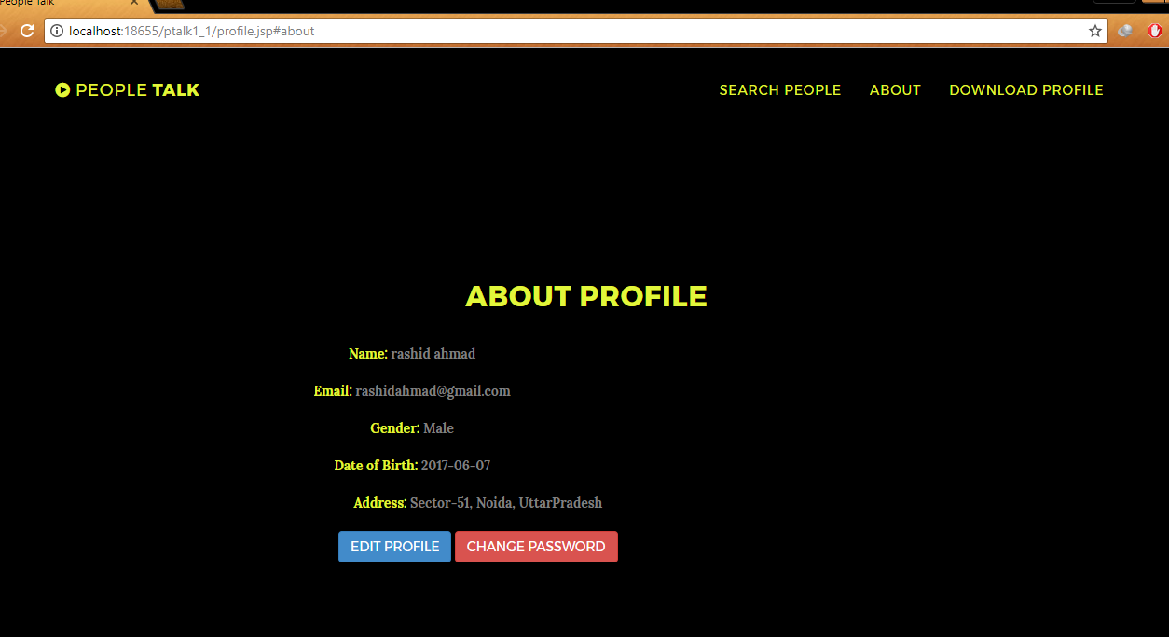
Profile Page (starting section)
Notes:
What will the audience be able to do after this training is complete? Briefly describe each objective how the audience will benefit from this presentation.

Slide 8
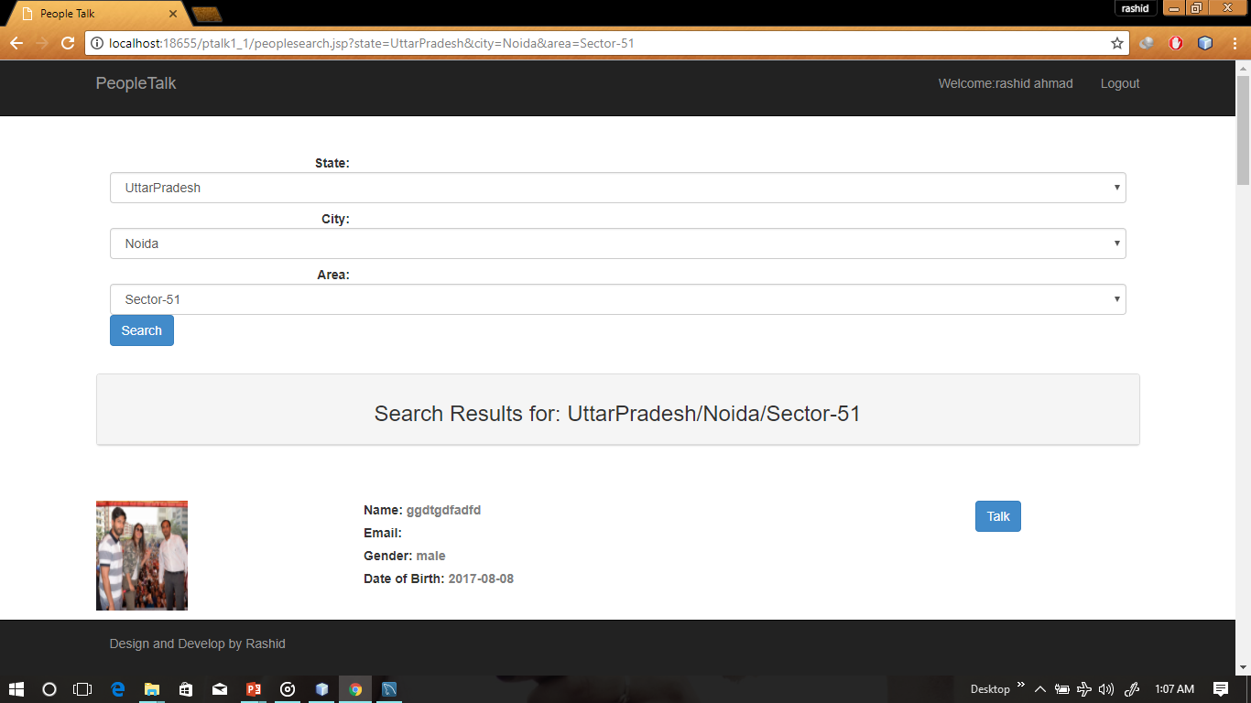
Searching Page
Notes:
What will the audience be able to do after this training is complete? Briefly describe each objective how the audience will benefit from this presentation.

Slide 9
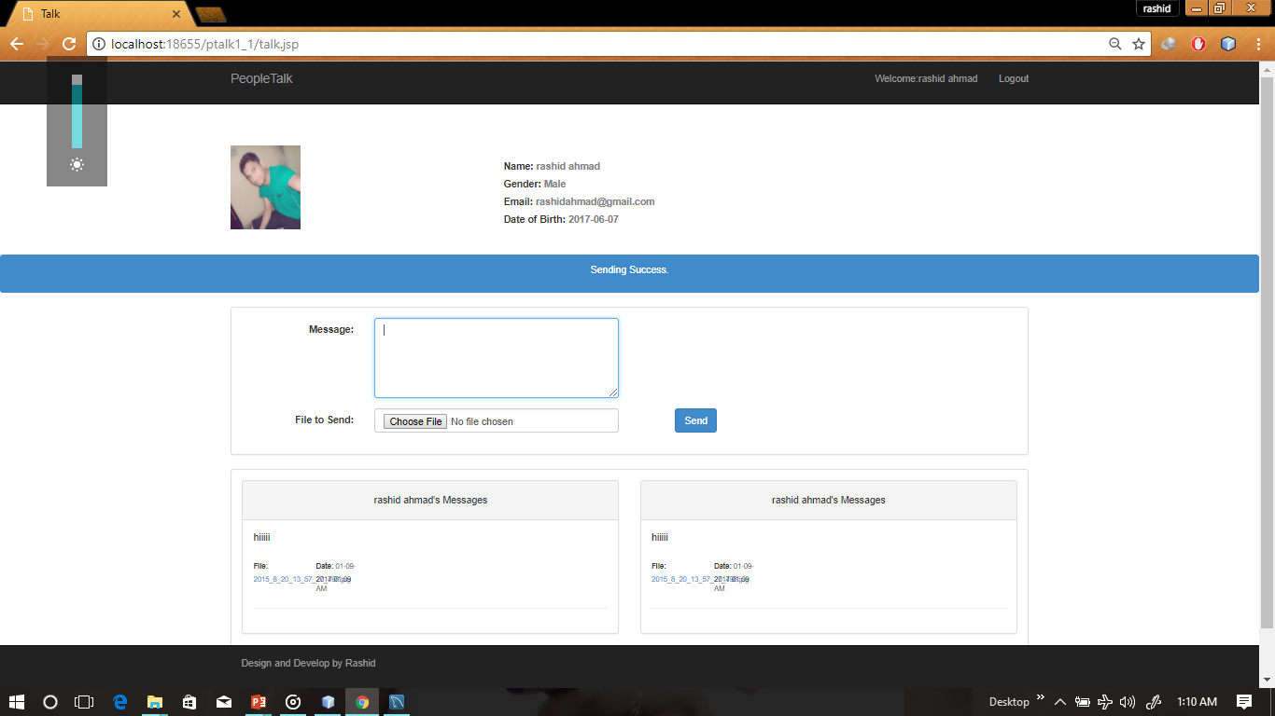
Talk Page
Notes:
What will the audience be able to do after this training is complete? Briefly describe each objective how the audience will benefit from this presentation.

Slide 10
database
MYSQL
SCHEMA NAME: PEOPLETALK
THERE ARE TWO TABLE .
1ST PTALK TABLE
2ND USERINFO TABLE
Notes:
Use a section header for each of the topics, so there is a clear transition to the audience.

Slide 11
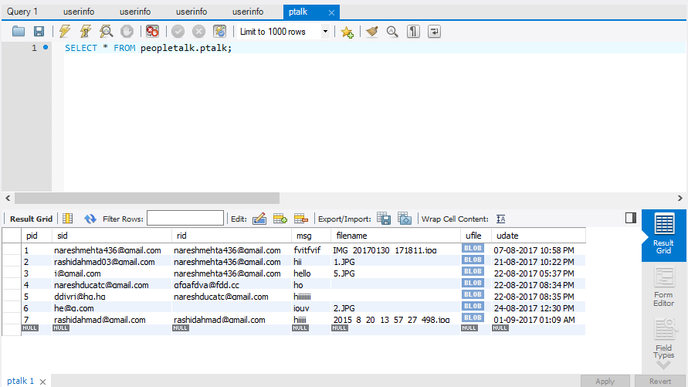
Database SNAPSHOT
PTALK TABLE
Notes:
Use a section header for each of the topics, so there is a clear transition to the audience.

Slide 12
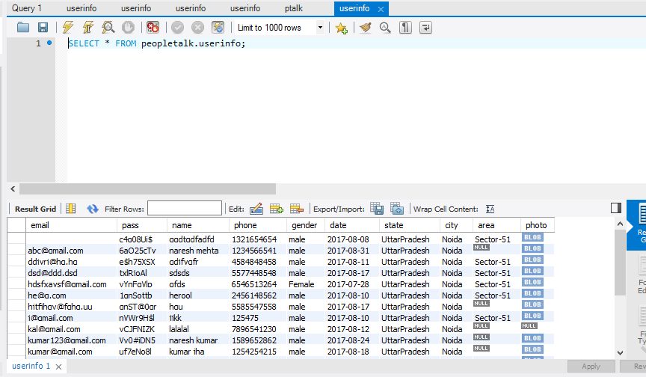
Database SNAPSHOT
USERINFO TABLE
Notes:
Use a section header for each of the topics, so there is a clear transition to the audience.

Slide 13
THANK YOU
Notes:
Is your presentation as crisp as possible? Consider moving extra content to the appendix.
Use appendix slides to store content that you might want to refer to during the Question slide or that may be useful for attendees to investigate deeper in the future.

